Slide 1
IBM University Engagement Project Submission
“Exploring the Power of Agentic AI with IBM Granite and LangFlow”

Slide 2

Project Title – AceIt – Smart Interview Preparation Agent Using LangFlow & IBM Granite
Domain of Project – Career Development & Education
Kanaka Durga MahaLakshmi Chellingi | Recent Passport Photo | 24h41a6113@bvcits.edu.in | 9392510415 9392510415 [WhatsApp]

Slide 3
Problem Statement No. 22 – Interview Trainer Agent
Problem Statement : Interview Trainer Agent
The Challenge
Candidates struggle to find role-specific questions, model answers, and structured preparation for competitive hiring environments.
Users input their resume or job title – agent provides targeted questions, model answers & improvement tips.
The Objective
Build an AI-powered Interview Trainer Agent that delivers personalized interview preparation and guidance for job seekers across all domains and experience levels. The solution should:
Role-Specific Question Bank – Tailored questions based on job role & experience level.
RAG-Based Answer Retrieval – Retrieves answers from recruitment portals & LinkedIn using RAG.
Answer Evaluation & Feedback – Scores user answers and provides model answers instantly.
Behavioral & Technical Preparation – Covers technical & soft skill rounds comprehensively.
Multi-Agent System – 4 specialized agents collaborate:
Question Generation Agent – Generates role-specific questions
Answer Evaluation Agent – Evaluates user responses & scores
Feedback & Tips Agent – Provides model answers & tips
Progress Tracker Agent – Tracks sessions & weak areas
Performance Dashboard – Tracks progress, weak areas & readiness score.

Slide 4
Technology Used
Langflow platform -For designing and orchestrating multi-agent workflows visually
IBM Granite model - for eg – ibm-granite-3-2-8b – For natural language understanding, reasoning, and personalization
IBM Cloud – It provides the infrastructure to build, deploy, and scale the Interview Trainer Agent efficiently. IBM Cloud enables a reliable, secure, and scalable environment for deploying the Interview Trainer Agent.
RAG– RAG to fetch real data first, then generate intelligent answers, making the agent more accurate and trustworthy.
IBM Watsonx.ai - For model deployment, embeddings, and AI governance
Vector Database (FAISS/Chroma) – For RAG-based interview Q&A retrieval

Slide 5
Proposed Solution -
Proposed Solution: AceIt – AI-Powered Interview Trainer Agent
The proposed solution is a multi-agent AI-powered Interview Trainer Agent built using LangFlow, IBM watsonx.ai, and Granite Models to provide personalized, real-time interview preparation. The system addresses challenges in question generation, answer evaluation, and career readiness through an intelligent, modular architecture.
At its core, the solution uses a Retrieval-Augmented Generation (RAG) pipeline to fetch accurate interview Q&A from trusted sources such as HR portals and LinkedIn. This data is embedded in a vector database, enabling the system to retrieve role-specific questions and model answers using Granite models.
The system consists of four key agents:
Question Generation Agent retrieves role-specific interview questions using RAG.
Answer Evaluation Agent evaluates user answers and provides scores and improvement tips.
Feedback & Tips Agent provides communication tips, body language advice, and HR round guidance.
Progress Tracker Agent tracks preparation history and highlights weak areas across mock sessions.
The solution includes a user-friendly dashboard (built with Streamlit or React) that visualizes preparation progress, highlights weak topics, and shows interview readiness score.
LangFlow is used to orchestrate agent workflows, while watsonx.ai ensures scalable model deployment, embeddings, and AI governance. Granite models power reasoning, summarization, and personalization.
Overall, this solution delivers an end-to-end intelligent Interview Trainer Agent that promotes interview readiness through personalized insights, real-time feedback, and higher hiring success rates.

Slide 6
Langflow component Used -
1) Chat Input – Interface where users enter their resume, job title, or interview responses (text/voice).
2) IBM watsonx AI Agent - Processes user input using Granite models to generate personalized interview questions and evaluation.
3) Name of IBM Granite model - Granite-4.0-8B-Instruct → For question generation and answer evaluation
4) Chat output -Displays AI-generated interview questions, model answers, and improvement feedback.
5) File component - Stores resume data, job descriptions, and question banks for personalized preparation.
6) Prompt Template – Structures the input prompt for IBM Granite model to generate accurate interview questions.

Slide 7
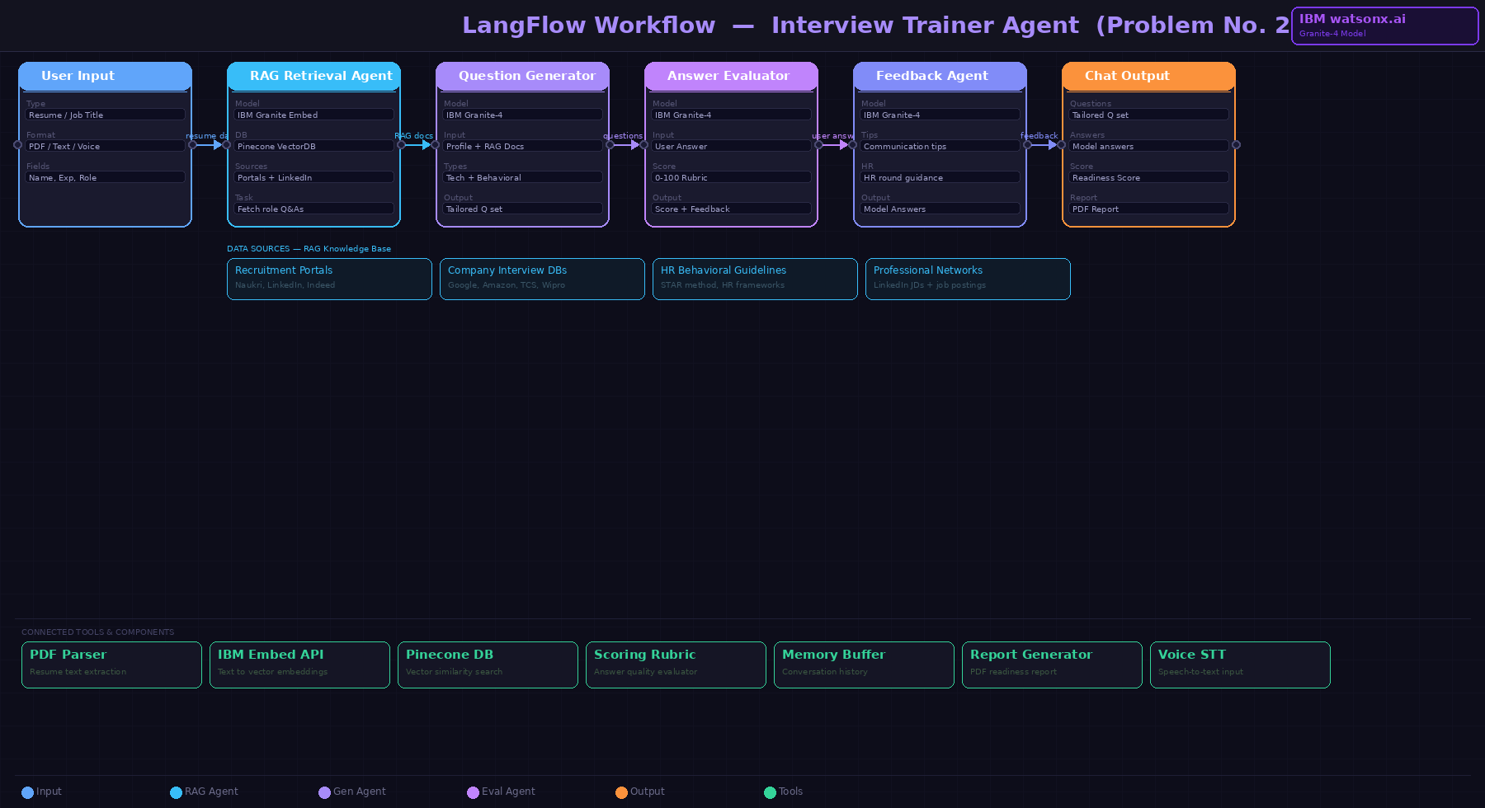
Langflow workflow -

Slide 8
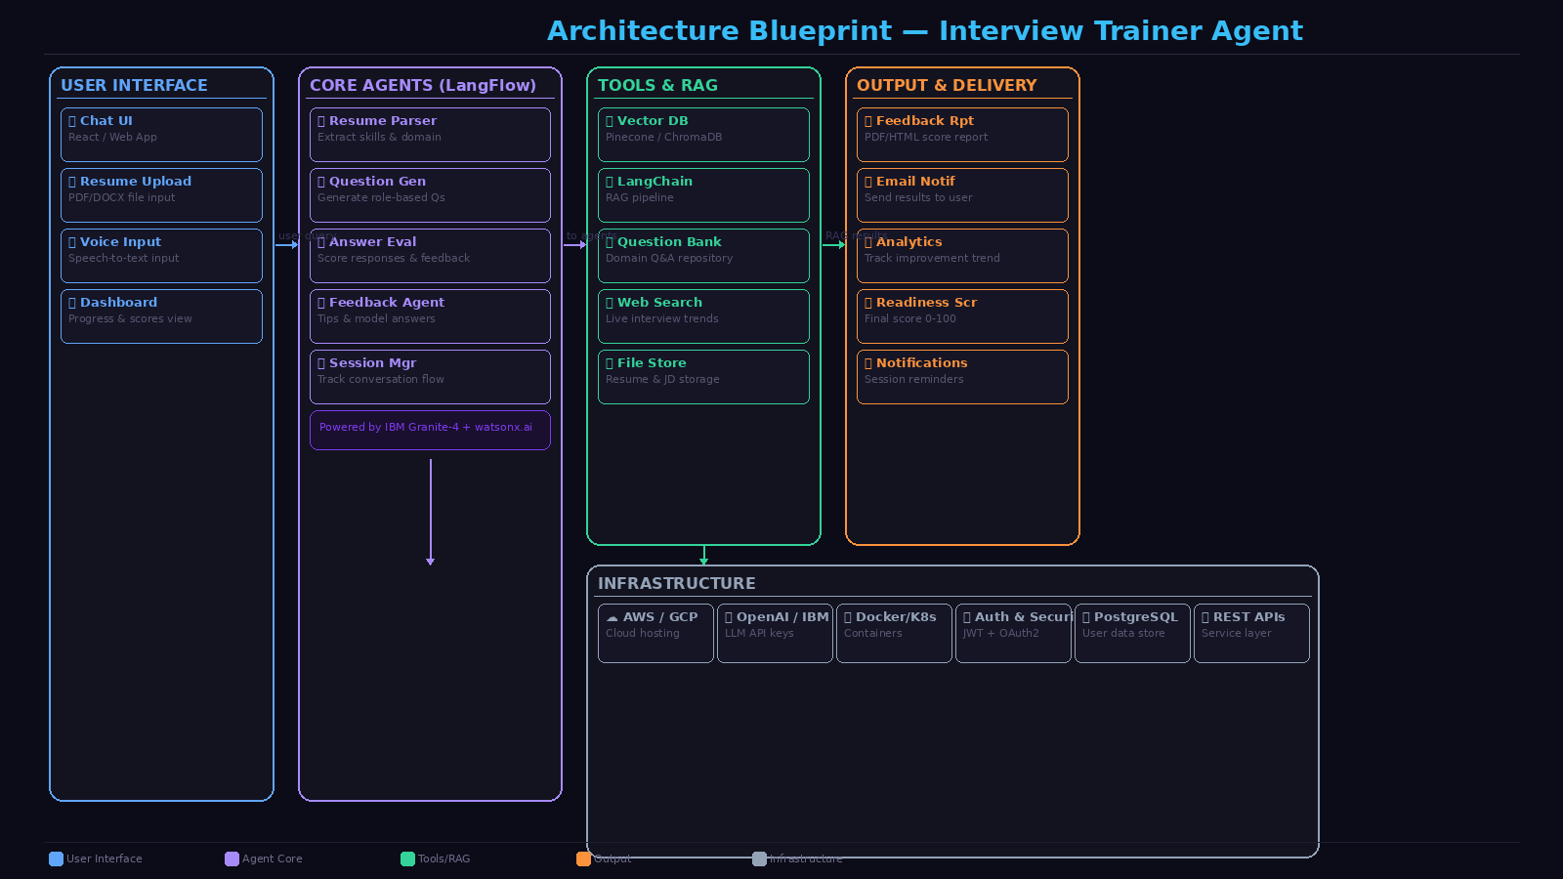
Architecture blueprint

Slide 9

Role of Agentic AI in the solution
Role of Agentic AI in Interview Trainer Agent
Agentic AI enables the Interview Trainer Agent to function as an intelligent, autonomous system rather than a simple chatbot. Using IBM watsonx.ai and IBM Granite models, it coordinates multiple specialized agents to deliver personalized interview coaching.
Each agent performs a specific role—such as retrieving interview questions, evaluating answers, providing feedback tips, and tracking progress—while working collaboratively. This multi-agent approach ensures efficient task execution and accurate results.
Agentic AI also brings context awareness, understanding user details like experience level, job role, and skill gaps to generate tailored interview questions. It supports real-time adaptation, continuously updating questions and feedback based on user performance.
Additionally, agents communicate with each other, sharing context between question generation, answer evaluation, and feedback for better interview coaching.
Overall, Agentic AI makes the system proactive, personalized, and goal-driven, acting like a smart digital interview coach that helps candidates succeed in competitive interviews.

Slide 10
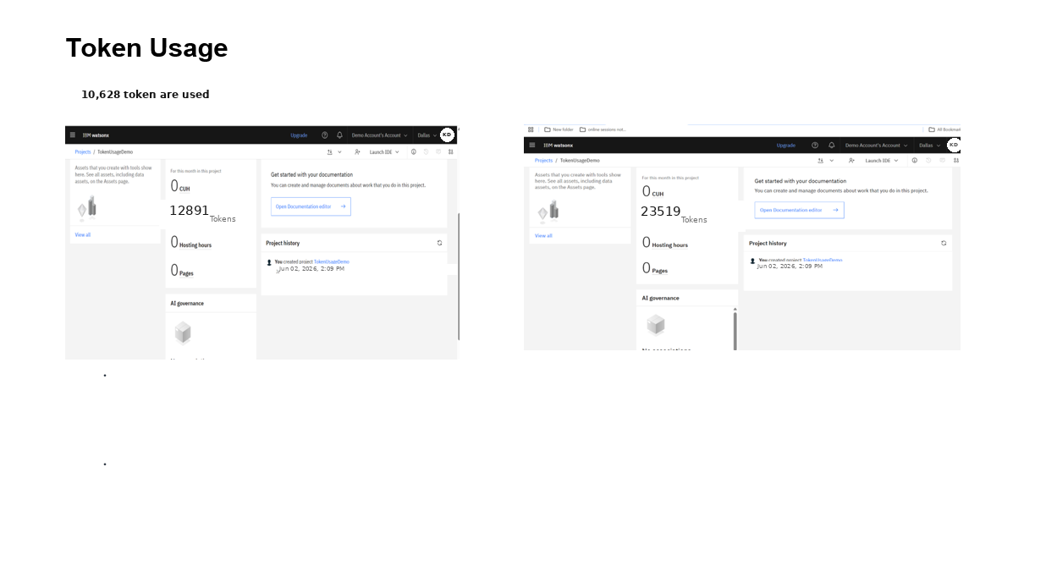

Slide 11
Novelty and Uniqueness
AceIt Interview Trainer Agent stands out by combining Agentic AI, RAG, and personalization into a single intelligent system.
Multi-Agent Intelligence – Instead of a single chatbot, multiple specialized agents collaborate to deliver accurate and context-aware interview preparation.
RAG-Based Accuracy – Retrieves real interview questions and model answers, ensuring up-to-date and relevant content.
Hyper-Personalization – Tailors questions based on job role, experience level, and skill gaps.
Real-Time Feedback Loop – Continuously adapts questions and difficulty based on user behavior.
Multi-Modal Input – Supports text and voice-based answer submission for flexible practice.
Comprehensive Coverage – Covers technical, HR, and behavioral rounds for complete interview readiness.
Scalable & Enterprise-Ready – Built on IBM watsonx.ai with IBM Granite models, ensuring reliability and governance.
This makes the solution a smart, adaptive, and proactive digital interview coach, not just a static question bank.

Slide 12
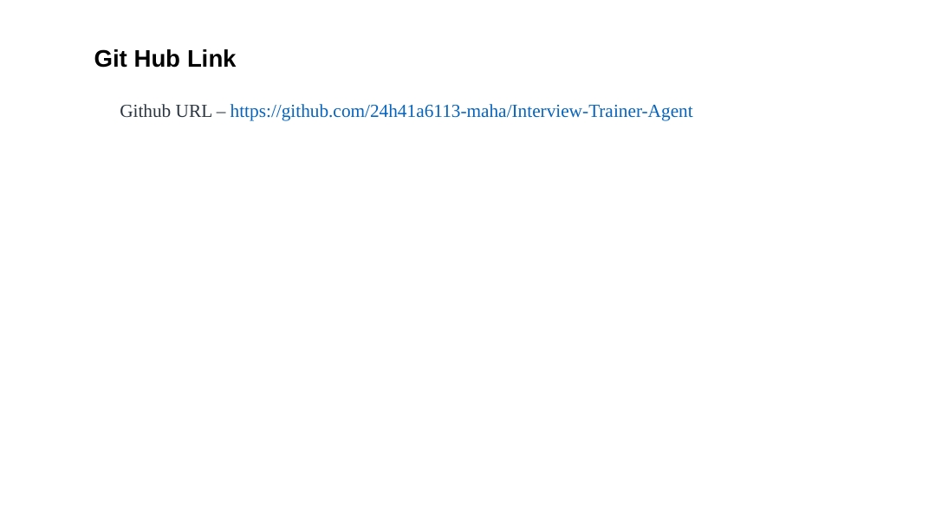

Slide 13
Future Scope
1. Integration with Job Portals & Resume Analysis –
The system can be integrated with LinkedIn and job portals to auto-fetch job descriptions and generate hyper-relevant questions, enabling smarter and more targeted interview preparation.
2.AI-Powered Voice Assistant & Multilingual Support –
Enhancing the system with video interview simulation will allow real-time analysis of tone and body language, giving candidates a complete mock interview experience to build confidence.
·
·
·

Slide 14


